Slide 1
Flaunt Website
R2: Iteration 3
Use Case Diagrams

Slide 2
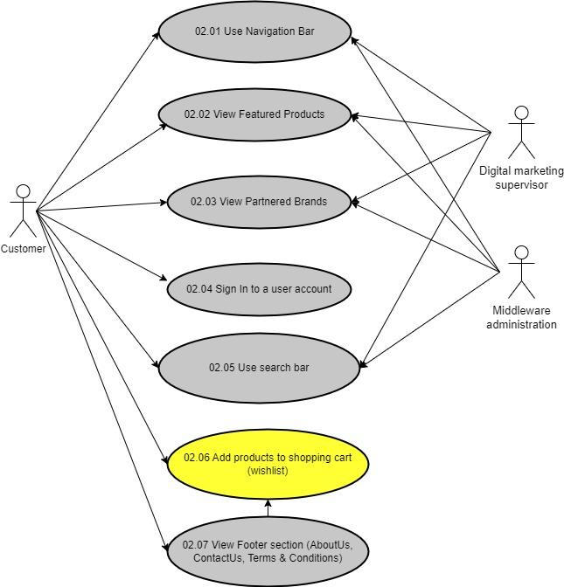
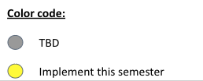
Flaunt Website
Module 02: Browse Product(s)
UC 02.06 Add products to shopping cart (wishlist)
Use Case Diagram

Slide 3
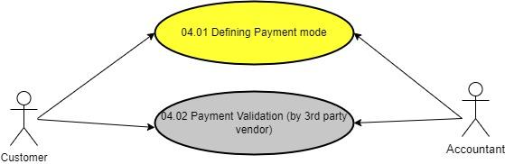
Flaunt Website
Module 04: Payment Gateway
UC 04.01 Defining Payment Mode
Use Case Diagram

